Slide 1
Linear Regression

Slide 2
Outline
What is Linear Regression?
Mathematical understanding
Types of Linear Regression
Loss Function
What is Ordinary Least Squares method?
Measure the goodness of fit line

Slide 3
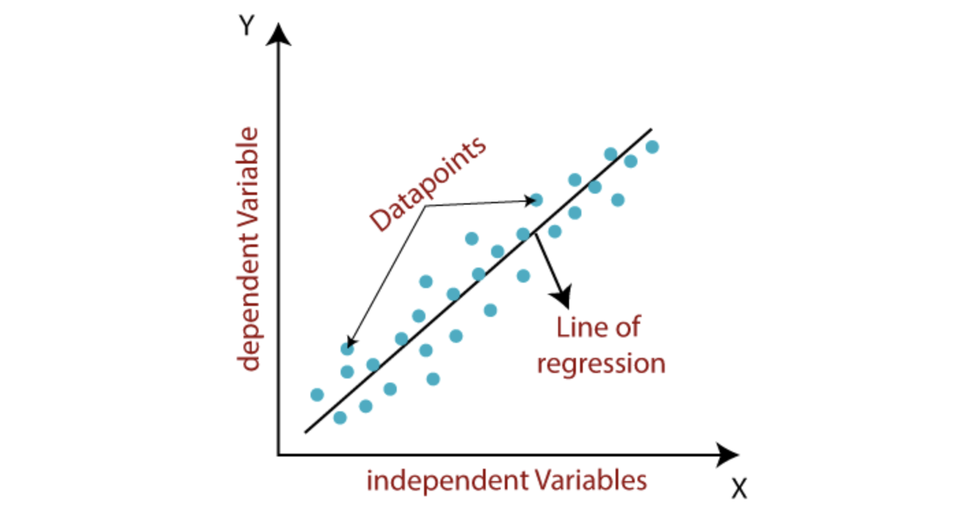
Linear Regression

Slide 4
Mathematical understanding

Slide 5
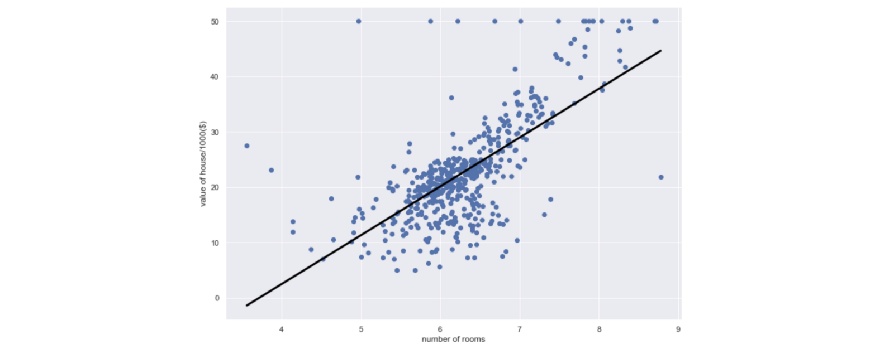
Example
Do all these features contribute equally to determining the house price?

Slide 6
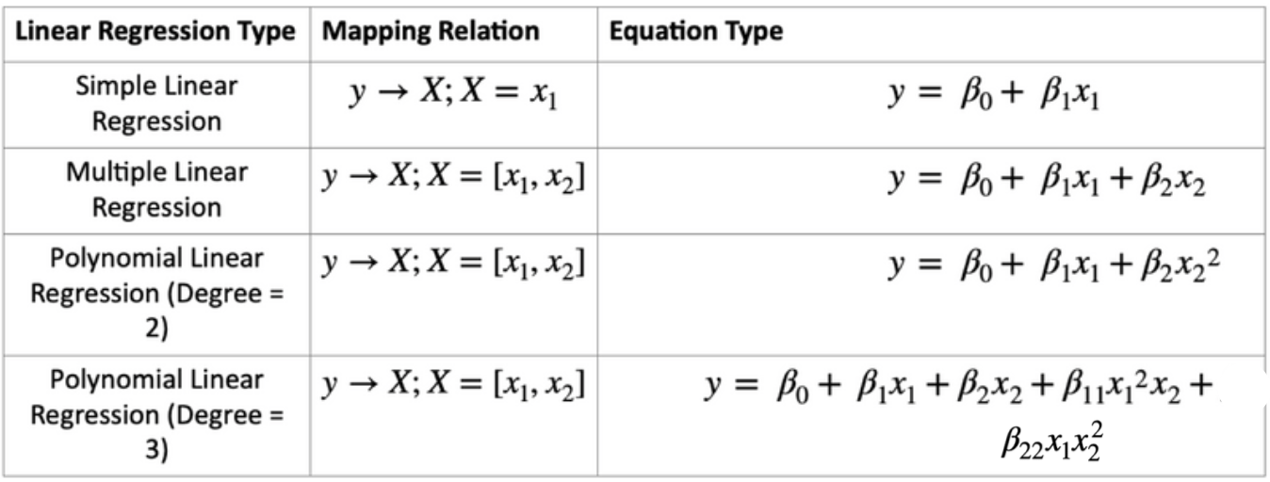
Types

Slide 7
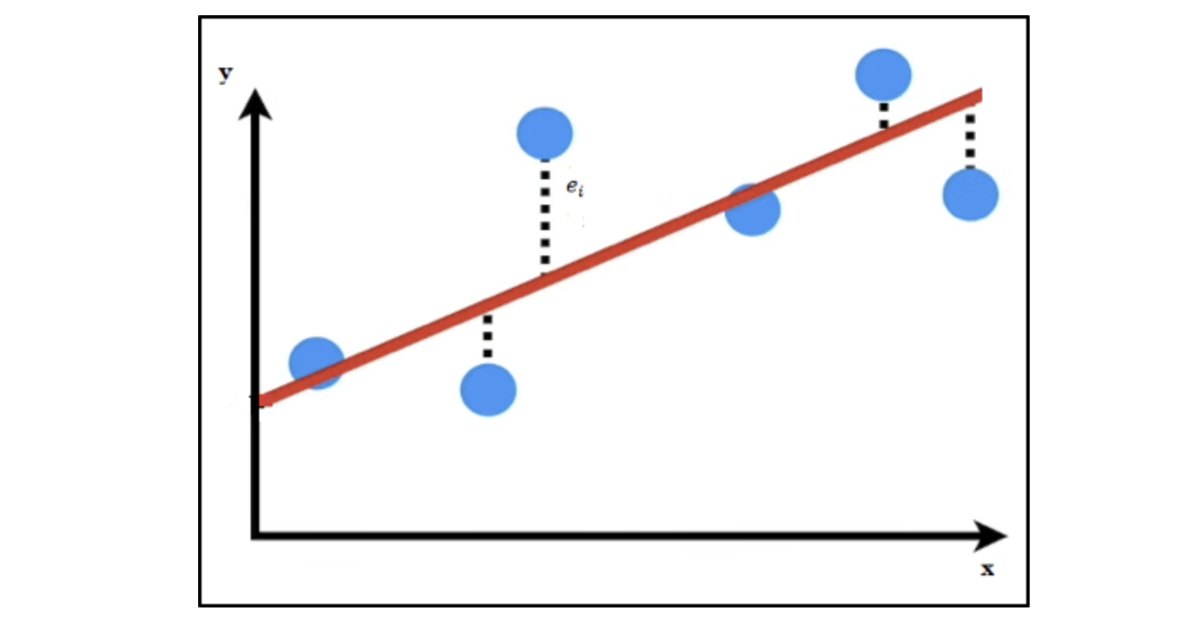
Loss Function

Slide 8
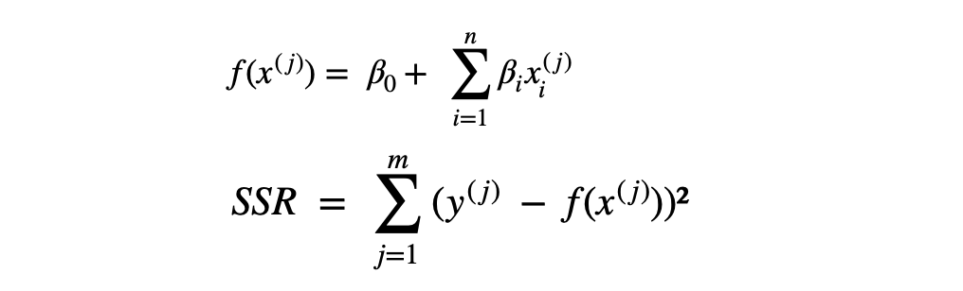
Loss Function

Slide 9
Optimization Techniques
Ordinary Least Squares
Gradient Descent

Slide 10
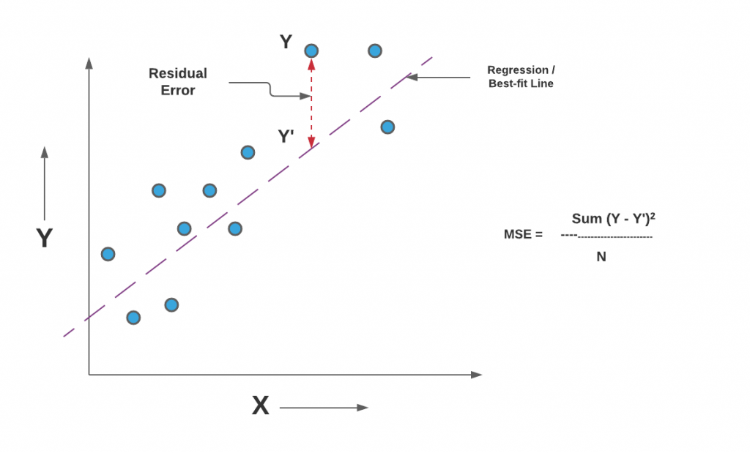
Find Best Fit Line

